Slide 1
A Universal Turing Machine

Slide 2

Universal Turing Machine
simulates any Turing Machine
Input of Universal Turing Machine:
Description of transitions of
Input string of

Slide 3
Tape 1
Three tapes
Description of
Tape 2
Universal
Turing
Machine
Tape Contents of
Tape 3
State of

Slide 4
Tape 1
Description of
We describe Turing machine
as a string of symbols:
We encode as a string of symbols

Slide 5








Alphabet Encoding
Symbols:
Encoding:

Slide 6






State Encoding
States:
Encoding:
Head Move Encoding
Move:
Encoding:

Slide 7
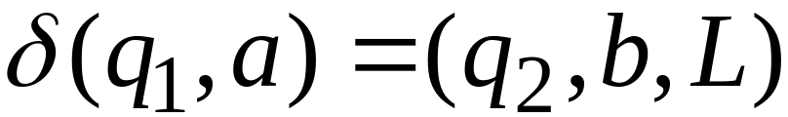
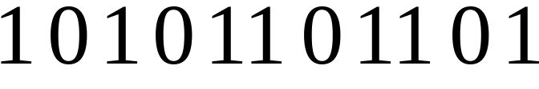
Transition Encoding
Transition:
Encoding:
separator

Slide 8
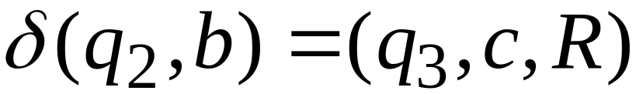

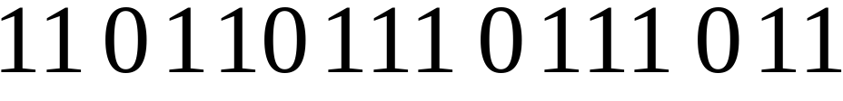
Turing Machine Encoding
Transitions:
Encoding:
separator

Slide 9
Tape 1 contents of Universal Turing Machine:
binary encoding
of the simulated machine
Tape 1

Slide 10
A Turing Machine is described
with a binary string of 0’s and 1’s
Therefore:
The set of Turing machines
forms a language:
each string of this language is
the binary encoding of a Turing Machine

Slide 11
Language of Turing Machines
L = { 010100101,
00100100101111,
111010011110010101,
…… }
(Turing Machine 1)
(Turing Machine 2)
……

